Slide 1

COVID-19 Data Analysis
Analyzing the Impact of COVID-19 Using Data Science.
Notes:
1

Slide 2

Global COVID-19 Trends: Cases, Deaths, and Recoveries
Early Spread
Vaccination Impact
Initial outbreak and spread.
Effect of vaccines on case rates.
1
2
3
4
Peak Infections
New Variants
Highest infection rates.
Emergence of new variants.
Notes:
4

Slide 3




Predictive Modeling: Forecasting Future Trends
Data Preparation
1
Model Selection
Prepare data for modeling.
2
Choose appropriate model.
4
Evaluation
Training
3
Evaluate the model.
Train model on existing data.
Notes:
7

Slide 4
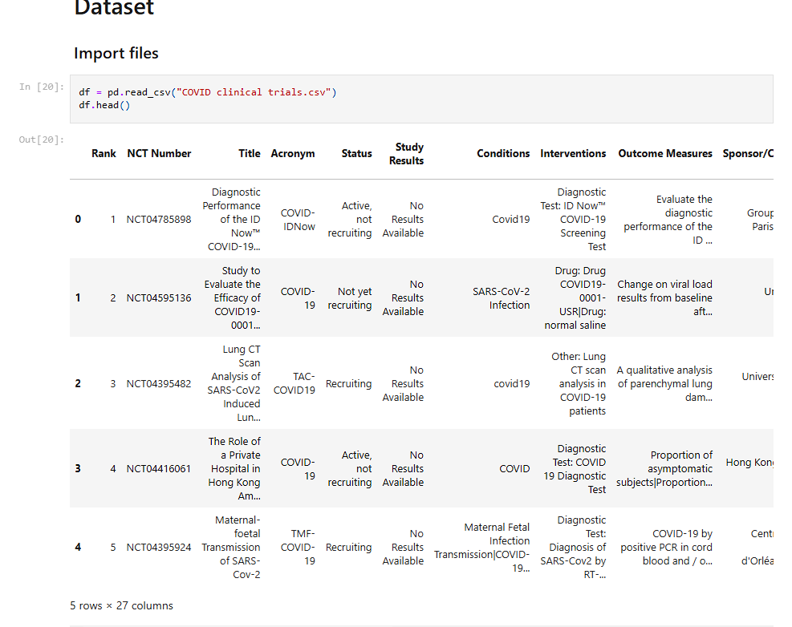
DATASET

Slide 5
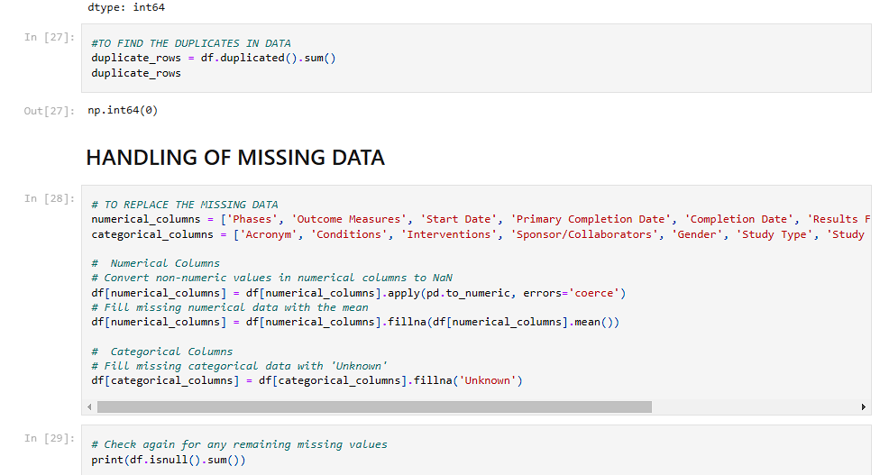
DATA CLEANING

Slide 6
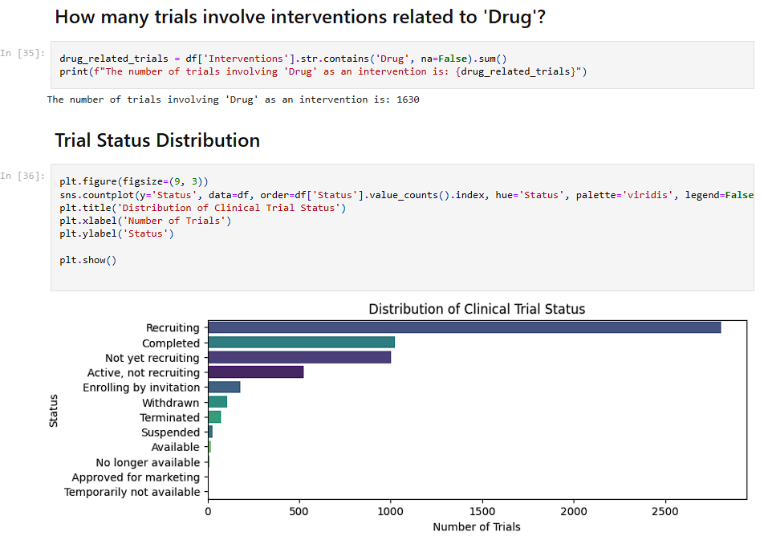
Distribution of clinical trails

Slide 7
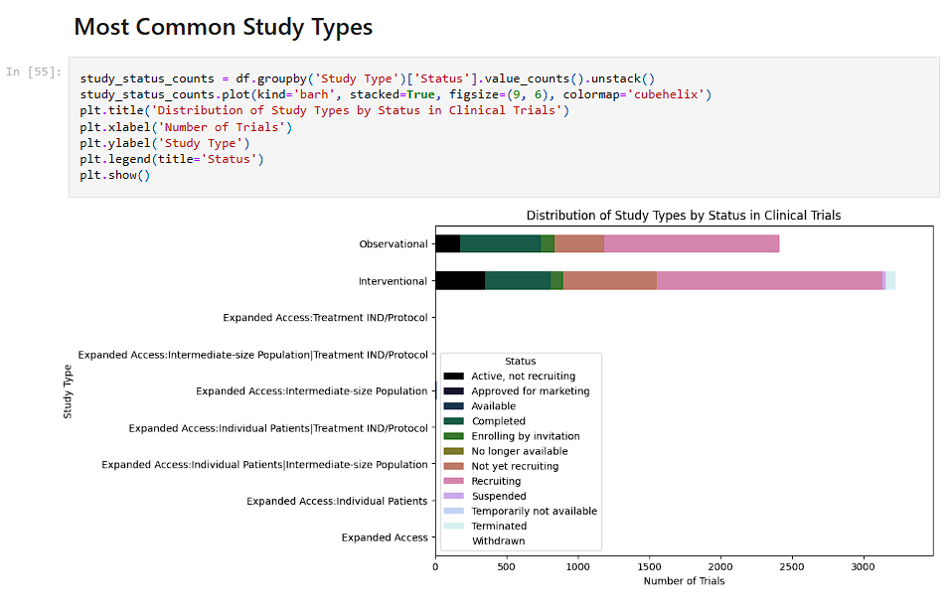
Distribution of Study Types
by Status in Clinical Trials

Slide 8
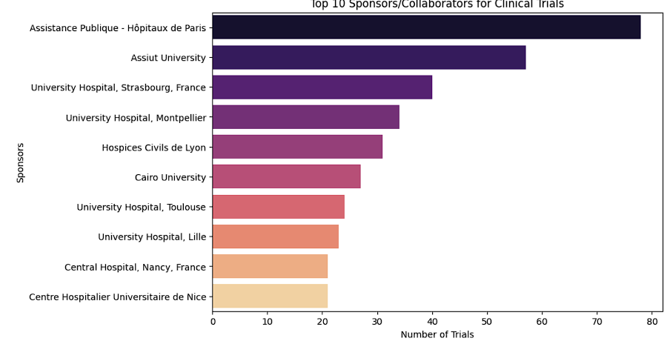
Top 10 Collaborators for Clinical
Trials

Slide 9
Impact Analysis: Socioeconomic Factors & COVID-19
Economic Impact
GDP changes due to lockdowns.
Education
School closures and learning loss.
Healthcare
Strain on healthcare systems.
Employment
Job losses across sectors.
Notes:
5

Slide 10
Conclusion: Key Insights and Future Research Directions
1
Key Insights
Summarize insights from the EDA.
2
Lessons Learned
Highlight successful techniques.
3
Future Studies
Suggest further research areas.
4
Policy Recommendations
Inform future responses.
Notes:
8

Slide 11
BY
SOURAV MOHANTY
thesouravmohanty@gmail.com

